Slide 1
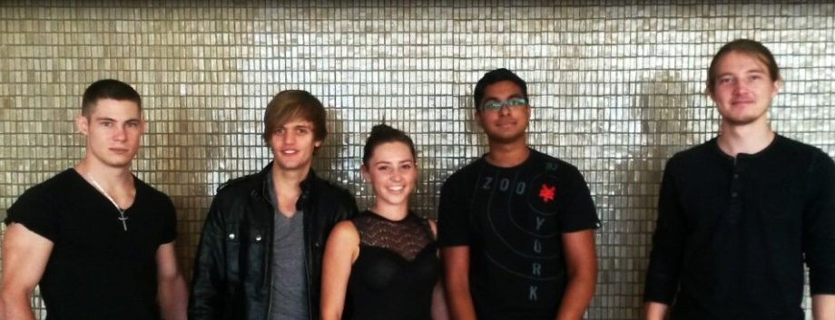
Team Eclectic
Project Linphone-Waterfall

Slide 2

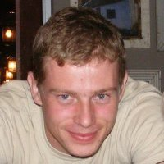
The Client
The Client 2.0
Kobus Coetzee

Slide 3

Getting Comfortable
Familiarized with current project
Made sure everyone is on the same page

Slide 4
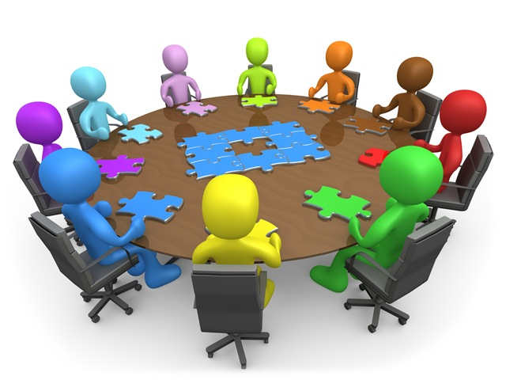
Documentation
SDD - Software Design Document
Classes and Interfaces
UI Design
Software Interactions

Slide 5
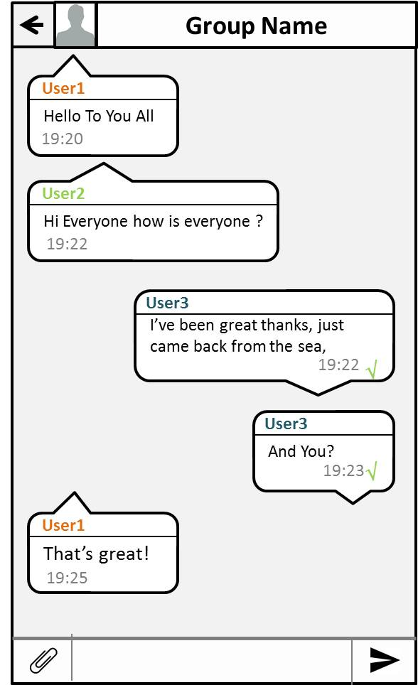
User Interface
UI for group chat
UI for creation of group chat
Group chat itself – several designs
Group chat information page
General UI improvement
Improvement ideas from personal and 3rd party experience

Slide 6
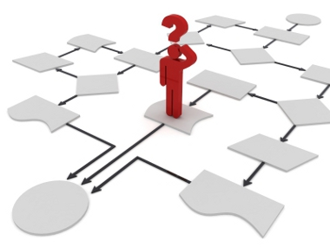
Core Functionality
Message encryption
Group data persistence
Managing group instances
Group communication

Slide 7


Challenges
Sub-modules, patches, compiling
Understanding the existing code and interfaces

Slide 8

Timeline
SRS
PSAC
SDD
Coding
Testing
Final Documentation
Completed 30th May
Completed 27th June
Completed 22nd July
Week of 29th July
August (continuous testing)
Early September (after product finalization)

Slide 9

Coding Goals
This week:
Creating code skeletons
Setting up unit testing
Before next demo:
A working app with core functionality

Slide 10

Thank You

